Slide 1
CMSC 603
High-Performance Distributed Systems
Concurrency and parallelism
Dr. Preetam Ghosh
Professor
Department of Computer Science
pghosh@vcu.edu

Slide 2

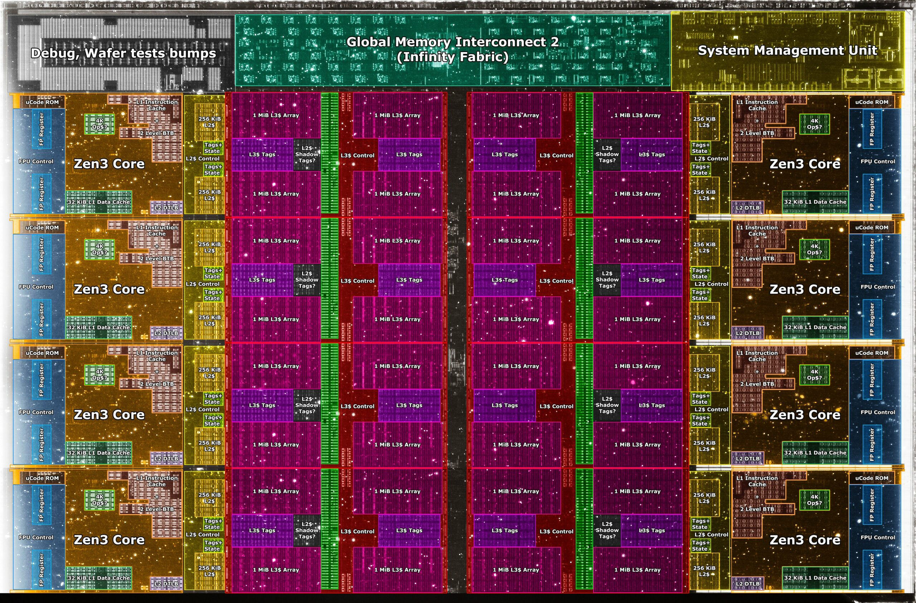

CMSC 603 - HPDS
Concurrency and parallelism
Physical view:
  Single-core CPU
  Simultaneous multi-threading (SMT/HT)
  Multi-core CPU
  Multi-processor system
  Cluster
  Grid
  Cloud
Scalability

Slide 3
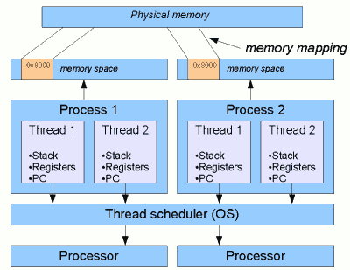
CMSC 603 - HPDS
Concurrency and parallelism
Logical view:
  Process: an instance of a computer program containing its own address space, virtual memory, stack / registers, file handles, etc.
  Thread: a single sequential flow of control within a program. Threads share the resources and memory of the process.
  OS kernel schedules threads independently
  Thread vs process context switching
  Creating threads is much faster

Slide 4
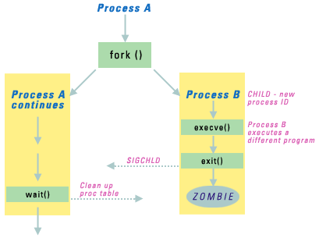
CMSC 603 - HPDS
Concurrency and parallelism
Creating processes (fork):
  fork produces a copy of the calling process, which starts execution after the call and copies all the process context (memory, files open, etc).
  The new process starts executing at the fork line (not at the beginning).
  The only difference between the copies is the return value: the parent gets the pid of the child, while the child gets 0.
pid = fork();
if ( pid < 0) {
fork_error_function();
} else if ( pid == 0 ) {
child_function();
} else {
parent_function();
}
pid_t getpid(void);

Slide 5
CMSC 603 - HPDS
Concurrency and parallelism
Creating threads (POSIX):
  POSIX threads API available by #include <pthread.h>
  Compile with flags: gcc -pthread program.c -o program
int pthread_create ( pthread_t* thread,
const pthread_attr_t* attr,
void* (* start_routine) (void*),
void* arg);
thread: creates a handle to a thread at pointer location
attr: thread attributes (NULL by default)
start_routine: function to start execution
arg: value to pass to start routine
returns 0 on success, error number otherwise
The thread starts executing as soon as the pthread_create function is called

Slide 6
CMSC 603 - HPDS
Concurrency and parallelism
Waiting for threads to complete:
Parent executes:
Child executes:
int pthread_join(pthread_t thread,
void** retval);
void pthread_exit(void *retval);
thread: data structure of the thread waiting to terminate.
retval: memory address to store the exit status of thread (set by pthread_exit) to the location pointed by retval. NULL is ignored. The memory address must be global to the process.
Only call exit one time per thread! Multiple calls on the same thread leads to undefined behavior.
Warning: if the main thread finishes without waiting for threads to join, threads will be killed!

Slide 7
CMSC 603 - HPDS
Concurrency and parallelism
Waiting for threads to complete:
Thread create and join syntax
Example: create_thread.c
#include <stdio.h>
#include <pthread.h>
void* run(void*) {
...
pthread_exit(0);
}
void main() {
pthread_t thread;
pthread_create(&thread, NULL, &run, NULL);
pthread_join(thread, NULL);
}

Slide 8

CMSC 603 - HPDS
Concurrency and parallelism
Threads 101:
Common mistake #1 (arguments to thread function):
Common mistake #2 (thread return value):
How to provide arguments to a function and return values correctly
Example: create_thread_arguments.c
create_thread_arguments_wrong.c
int i;
for (i = 0; i < 10; i++)
pthread_create(&thread[i], NULL, &run, (void*)&i);
int result;
pthread_exit(&result);

Slide 9
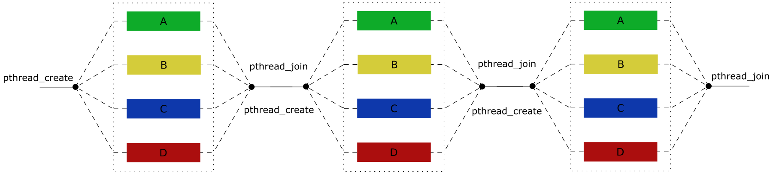
CMSC 603 - HPDS
Concurrency and parallelism
Performance impact of creating / joining threads (overhead):
Example: sequential_parallel.c

Slide 10
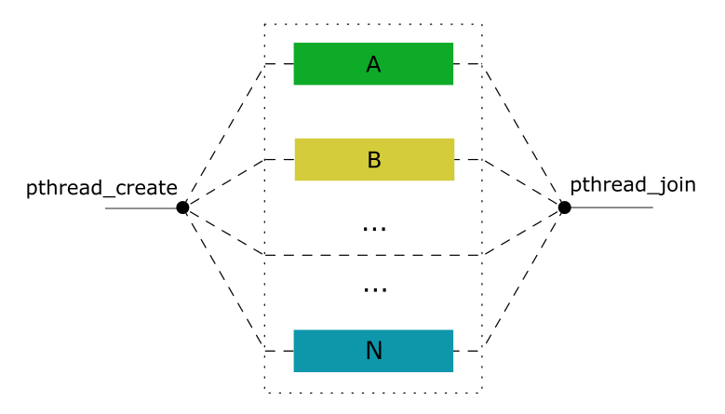
CMSC 603 - HPDS
Concurrency and parallelism
Performance impact of creating / joining threads (overhead):
Example: sequential_parallel_flood.c

Slide 11
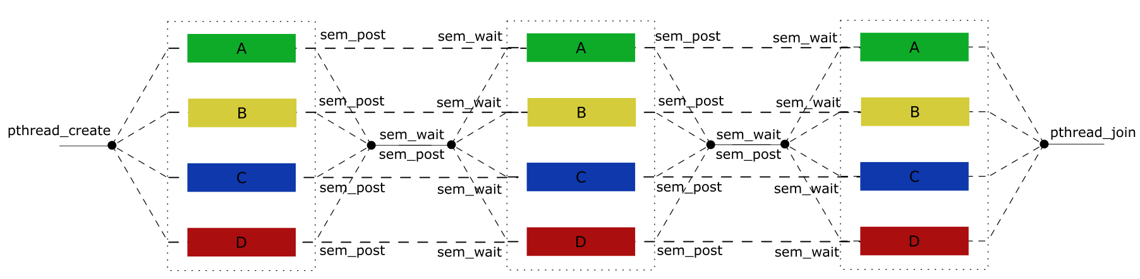

CMSC 603 - HPDS
Concurrency and parallelism
Performance impact of creating / joining threads (overhead):
Example: sequential_parallel_persistent_threads.c

Slide 12
CMSC 603 - HPDS
Concurrency and parallelism
Thread safety:
  Code is thread-safe if it manipulates shared data structures only in a manner that guarantees a safe execution by multiple threads
  Race conditions and reentrancy
  Example: race.c
  race2.c
  vector_race.cpp
int* x;
void* run1(void* arg) {
*x += 1;
}
void* run2(void* arg) {
*x += 2;
}
run1 run2
D.1 = *x; D.1 = *x;
D.2 = D.1 + 1; D.2 = D.1 + 2
*x = D.2; *x = D.2;

Slide 13
CMSC 603 - HPDS
Concurrency and parallelism
Detecting data races automatically:
  Dynamic and static tools can help find data races in your program
  helgrind analyzes your program (and causes a large slowdown)
  Run with valgrind --tool=helgrind <prog>
  It will warn you of possible data races along with locations
  For useful debugging information, compile with debug mode (-g)
  Examples:
    sudo apt install valgrind
      valgrind --tool=helgrind ./race
      valgrind --tool=helgrind ./vector_race

Slide 14
CMSC 603 - HPDS
Concurrency and parallelism
Mutual exclusion: locks
  Mutexes are the most basic type of synchronization
  Only one thread at a time can execute code protected by a mutex
  All other threads must wait until the mutex is free before they can execute protected code
  Example: vector_race_mutex.cpp
pthread_mutex_t m; // C99
pthread_mutex_init(&m, NULL);
// code
pthread_mutex_lock(&m);
// protected code, critical section
pthread_mutex_unlock(&m);
// more code
pthread_mutex_destroy(&m);
mutex m; // C++11
// code
m.lock();
// protected code, critical section
m.unlock();
// more code

Slide 15
CMSC 603 - HPDS
Concurrency and parallelism
Mutual exclusion: semaphores
  Binary: equal to a mutex if the initial value is 1
  Counting semaphores: any number of threads at the same time
  A pair of semaphores can be useful to synchronize the main process and its threads when iterating in a loop
  Example: producer_consumer.c
#include <semaphore.h>
int sem_init(sem_t *sem, int pshared, unsigned int value);
int sem_post(sem_t *sem);
int sem_wait(sem_t *sem);
int sem_destroy(sem_t *sem);

Slide 16
CMSC 603 - HPDS
Concurrency and parallelism
Mutual exclusion: atomic operations
  An atomic operation is indivisible
  Objects of atomic types are the only objects that are free from data races, that is, they may be modified by two threads concurrently or modified by one and read by another.
  Examples: atomic.c
  atomic_performance.c
#include <stdatomic.h> //C11
atomic_int counter;
#include <atomic> //C++11
atomic<int> counter;

Slide 17

CMSC 603 - HPDS
Concurrency and parallelism
Exercise: Unisex restroom problem
  There is a single unisex restroom with a defined maximum capacity. The restroom may fill up to its capacity of people of the same gender, who each stay for a random time and then leave. People of other genders must wait and may only enter once the restroom is empty. Create a C program for any number of genders and capacity that simulates the occupancy of the restroom over time.
  One example solution on Github
  Example: restroom_with_capacity.c

Slide 18
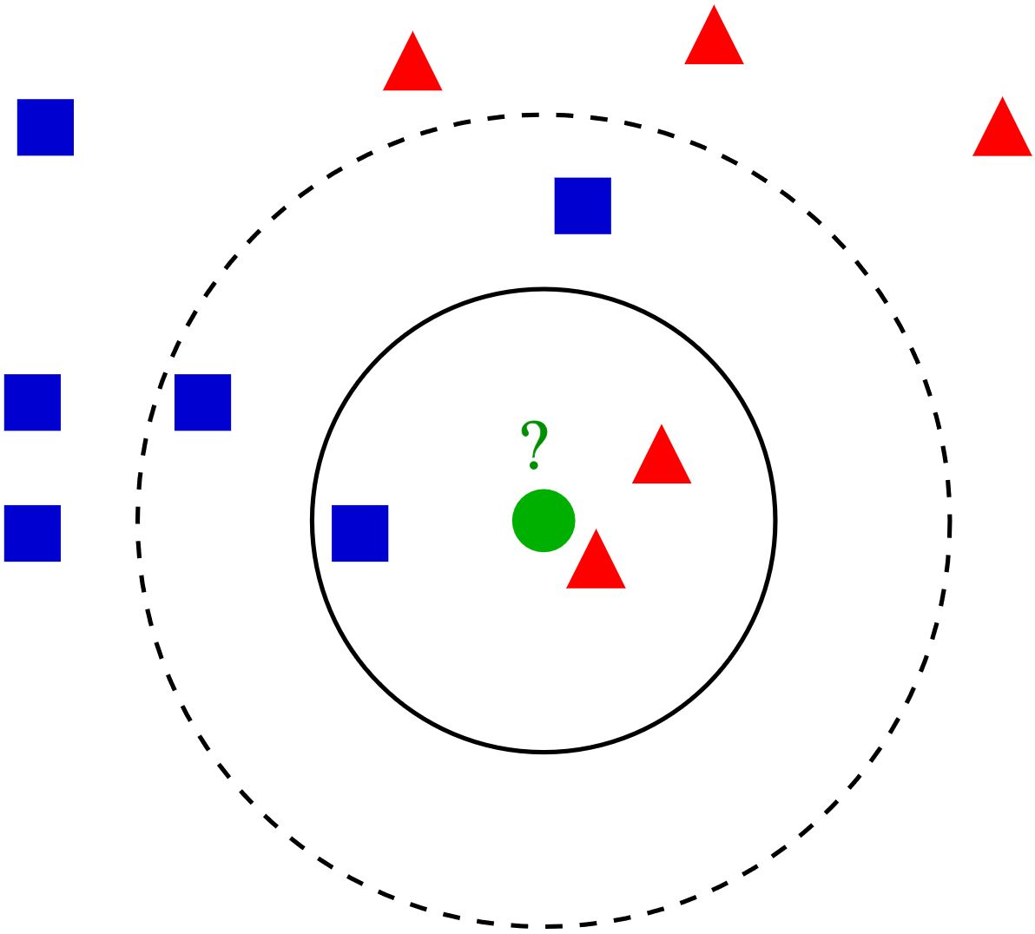
CMSC 603 - HPDS
KNN
The K-Nearest Neighbor classifier
  Classifies a data instance based on the majority vote of the k-nearest neighbors
  For every test instance need to calculate the distance to every train instance
  Computational complexity O(num_test x num_train x num_features)
  Run the KNN code provided in Assignment 1
  Compare runtimes in maple and athena
  Approaches to parallelize and speed up the code?
    Assignment 1: threads, OpenMP, MPI
    Assignment 2: CUDA on the GPU

Slide 19
CMSC 603
High-Performance Distributed Systems
Concurrency and parallelism
Dr. Preetam Ghosh
Professor
Department of Computer Science
pghosh@vcu.edu

